Slide 1



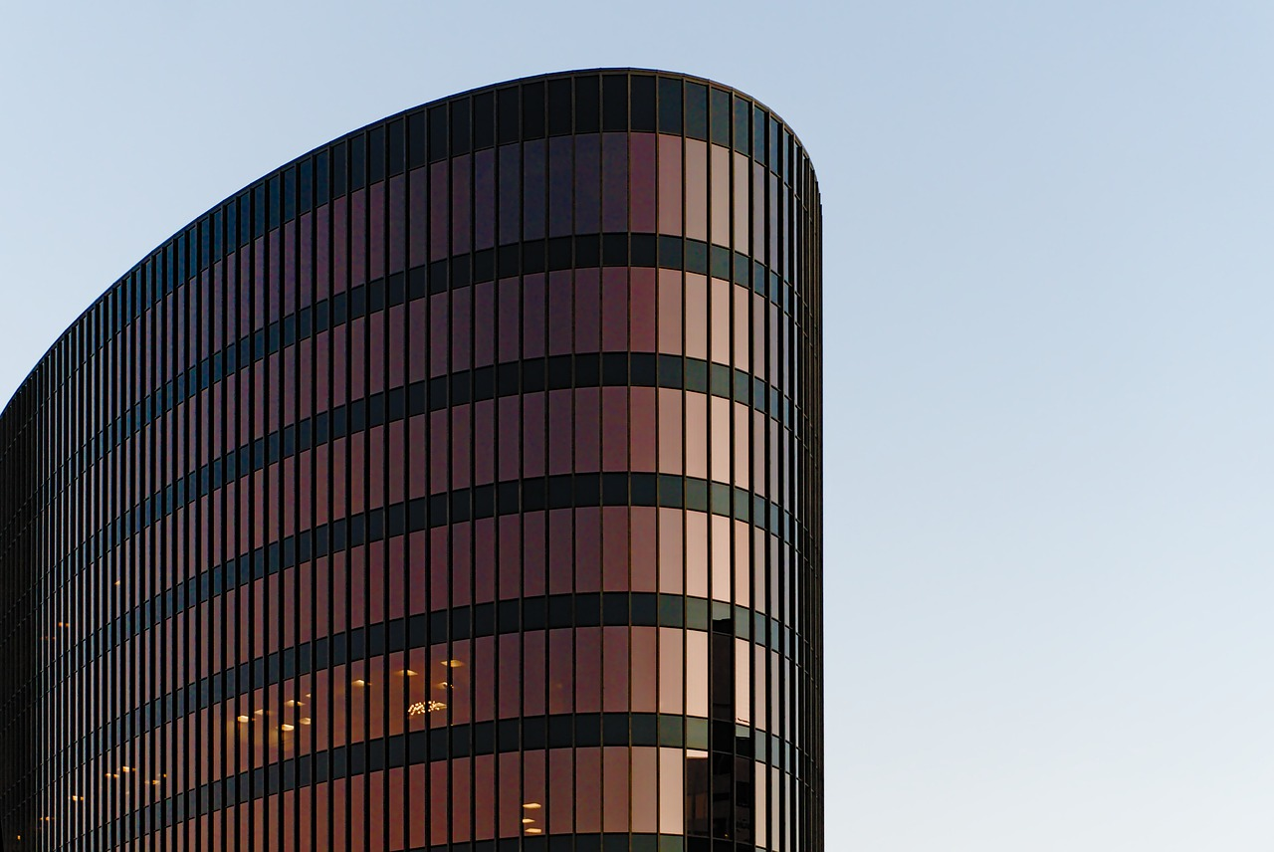
FINM542: Corporate Finance - 1
Working Capital Management

Slide 2
Live industry exposure
https://www.capitalmarket.com/Company-Information/Financials/Balance-sheet/Reliance-Industr/476
https://www.tatamotors.com/investors/annual-reports/

Slide 3
1
Working Capital Management
Meaning:
A company’s short term financial decisions and how it affects current assets and current liabilities. By definition, the current assets are expected to convert to cash after appearing on the firm’s ‘Balance Sheet’

Slide 4
2
Current Assets
In B/S, Current assets are presented in the order of liquidity

Slide 5
3
Current Liabilities

Slide 6
4
Working Capital
Gross Working Capital:
It represents to Investment in current assets, i.e., the assets which can be converted into cash within an accounting year.

Slide 7
5
Working Capital
Net Working Capital:
Difference between current assets and current liabilities. Generally, whenever we talk about working capital, we talk in the sense of Net Working Capital
Current Assets – Current Liabilities

Slide 8
6
Working Capital
Permanent Working Capital:
Permanent or fixed working capital is the minimum level of required current assets. Depending upon the changes in production and sales, the need for working capital, over and above the permanent working capital, will fluctuate, that additional requirement is filled through Temporary Working Capital.

Slide 9
7
Working Capital
Variable Working Capital:
Variable/ temporary/ Fluctuating extra working capital needed to support the changing production and sales activities of the firm. The firm, to meet liquidity requirements that will last only temporarily, creates a temporary working capital. It is always over and above Permanent Working Capital

Slide 10
8
Determinants of Working Capital
Nature of business
Length of period of manufacture
Volume of business
The proportion of the cost of raw materials to total cost
Use of Manual Labour or Mechanization
Need to keep large stocks of raw materials of finished goods
Turnover of working capital
Terms of Credit
Seasonal Variations
Requirements of Cash
Other Factors

Slide 11
9
Nature of Business
Nature of the business determines the Working Capital requirements. The trading or manufacturing concerns will require more amount of working capital as compared to public utility companies. Public utilities companies with huge fixed investment usually have the lowest needs for current assets, partly because of cash, nature of their business and partly due to their selling a service instead of a commodity.

Slide 12
10
Length of period of manufacture
The average length of manufacture period, i.e., the time which elapses between the commencement and end of the manufacturing process is an important factor in determining the amount of the working capital. If it takes less time to make the finished product, the working capital required will be less, e.g., a baker requires one nighttime to bake his daily quota of bread. His working capital is, therefore, much less than that of a ship­building concern which takes three to five years to build a ship.

Slide 13
11
Volume of Business
The size of the company has a direct relation with the working capital needs. Big concerns must keep higher working capital for investment in current assets and for paying current liabilities as compared to small sized companies.

Slide 14
12
Proportion of cost of raw material to total cost
Where the cost of raw materials to be used in manufacturing of a product is very large in proportion to the total cost, working capital required will also be more e.g., Sugar Mill. Whereas, If the importance of materials is less the need of working capital will be naturally less e.g., Oxygen Plant

Slide 15
13
Use of manual labour or mechanisation
In the labour-intensive industries, larger working capital will be required than in the highly mechanized ones. The latter will have a large proportion of fixed capital.

Slide 16
14
Need to keep large stocks of raw materials, finished goods
The manufacturing concerns generally have to carry stocks of raw materials and other stores and also finished goods. The larger the stocks (whether of raw materials or finished goods) more will be the needs of working capital. Whereas service industries will need less working capital compared to manufacturing concerns.

Slide 17
15
Turnover of working capital
Turnover means the speed with which the working capital is recovered by the sale of goods. In certain businesses, sales are made quickly, and the stocks are soon exhausted, in such cases, a small amount of money invested in stocks will result in sales of much larger volume, e.g., textile industry. Whereas in some businesses, sales are made irregularly e.g., jewellery, in such cases, large sums of money have to be kept invested in stocks.

Slide 18
16
Terms of Credit
A company purchasing all raw-materials for cash and selling on credit will be requiring more amount of working capital compared to an enterprise buying on credit and selling on cash. The length of the period of credit has a direct bearing on working capital.

Slide 19
17
Seasonal Variations
Seasonal industries producing or selling largely based on season will have seasonally, higher working capital requirement, e.g., sugar industry producing sugar in winter will have more working capital requirement in the months of winter whereas a hosiery industry will have more working capital requirement 2-3 months before the start of winter season for increasing the production. Once the season is off, working capital requirement will gradually decline.

Slide 20
18
Requirements of Cash
The need to have cash in hand to meet various requirements e.g., payment of salaries, rents, rates etc., has an effect on the working capital. The more the cash requirements the higher will be working capital needs of the company and vice versa.

Slide 21
19
Other Factors
In addition to the above-mentioned considerations there are multiple other factors which affect the requirements of working capital such as:
Degree of co-ordination between production and distribution policies.
Specialization in the field of distribution.
Developments of means of transportation and communications.
The hazards and contingencies inherent in the type of business.

Slide 22
Solution of working capital problem
https://yourstory.com/video/india-msme-summit-solving-working-capital-problem

Slide 23
20
Operating Cycle
Operating cycle is the time duration required to convert sales into cash. The operating cycle of a manufacturing company involves three phases:
Acquisition of resources such as raw material, labour, power and fuel, etc.
Manufacture of the product which includes conversion of raw material into work-in-progress and then into finished goods.
Sale of the product either for cash or on credit. Credit sales create accounts receivable for collection.
Collection of cash from account receivable

Slide 24
21
Cash
Collection of Accounts Receivable
Holding Period
Purchases
Collection Period
Sale
Production
Operating Cycle

Slide 25
Various Components of Operating Cycle
A) Raw material shortage period = Average stock of raw material Average cost of raw material consumed per day
B) WIP holding period = Average WIP inventory Average cost of production per day
C) Finished goods storage period = Estimated production (in units) * direct lab permit 12 months / 360 days OR Average stock of finished goods Average cost of goods sold per day
D) Debtors collection period = Average goods debtors Average credit sale per day
E) Credit period available to suppliers = Average rate credit Average credit purchase per day

Slide 26
Operating Cycle = R+W+F+D-C

Slide 27
22
Gross Operating Cycle
GOC= Inventory Conversion Period (ICP) + Debtor Conversion Period (DCP)

Slide 28
23
Net Operating Cycle
Net Operating Cycle (NOC)=
Gross Operating Cycle (GOC) – Creditor Deferral Period (CDP)

Slide 29
24
Working Capital Policies
Conservative Policy
Average Policy
Aggressive Policy

Slide 30
25
Working Capital Policies
A. Conservative Policy
B. Average Policy
Level of Current Assets
C. Aggressive Policy
Fixed Asset Level
Output

Slide 31
26
Conservative Policy
A Conservative Working Capital Policy believes in higher investment in Working Capital. The policy strives on the fact that liquidity is more important for a company. The company must not face liquidity crunch. However, higher liquidity leads to compromise with profitability

Slide 32
28
Aggressive Policy
An Aggressive Working Capital Policy believes in lower investment in Working Capital. The policy strives on the fact that Profitability is more important for a company. The must maintain minimum level of working capital and must not compromise with profitability. It assumes lower liquidity, higher risk and higher profitability.

Slide 33
27
Average Policy
An Average Working Capital Policy believes in moderate investment in Working Capital. The policy strives on the fact that both liquidity and profitability important for a company. The company must not face liquidity crunch while maintaining the level of profits. It strikes a good tradeoff between liquidity and profitability.

Slide 34
29
Liquidity vs Profitability: Risk Return Tradeoff
Firms two main objectives are SOLVENCY and PROFITABILITY. For solvency more investment in working capital is inevitable; however, it leads to compromise with PROFITABILITY. So, a company trades off between liquidity and profitability to ensure solvency and good profitability.

Slide 35
Statement of Working capital requriement
Current Assets
Current liabilities
Net working capital =A-B
Add-10% for contingencies
Total working capital required

Slide 36
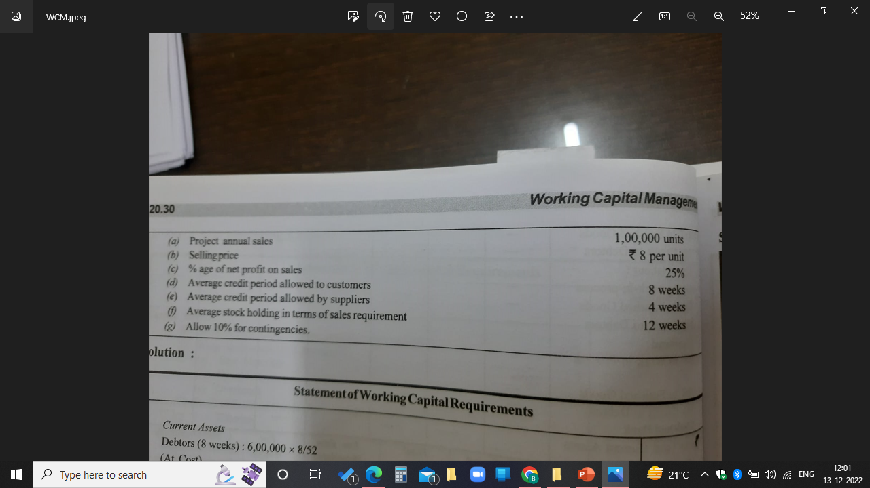

Slide 37
